Slide 1

Decoding Machine Learning Metrics
Why your model results look so detailed—and why that matters.

Slide 2
Beyond Accuracy

Slide 3


Global View vs. Class-Specific View
The Accuracy Trap
The Detailed View
Accuracy gives you a single percentage for the entire dataset. While 98% sounds great, it doesn't tell you if the model is failing on a specific, rare species.
The Classification Report breaks performance down by each species. It shows you exactly where the model is "confused" and where it is perfect.

Slide 4






The Three Pillars of Performance
Precision
Recall
F1-Score
Of all the times the model predicted a species, how often was it actually right? It's about "Quality".
Of all the actual flowers of a species, how many did the model find? It's about "Quantity".
The harmonic mean that balances both. It ensures you have high quality AND high quantity.

Slide 5


Precision: Quality of Predictions
Precision Focus
In your results, Setosa has a Precision of 1.00. This means every single time the model said a flower was a Setosa, it was correct. There were zero "False Alarms" for this class.

Slide 6


Recall: Completeness of Detection
Recall Power
Recall measures if the model is "missing" anything. For Versicolor, your Recall was 0.94. This means the model caught 94% of the actual Versicolors, but missed a small few.

Slide 7
Overall System Strength
0.98
Weighted F1-Score
Your model achieved a weighted average of 0.98. This indicates an exceptionally high level of balance across all three iris species, considering the number of samples for each.

Slide 8
Your Classification Report Analysis
Species | Precision | Recall | F1-Score | Support
Setosa | 1.00 | 1.00 | 1.00 | 16
Versicolor | 1.00 | 0.94 | 0.97 | 18
Virginica | 0.92 | 1.00 | 0.96 | 11
Averages | 0.98 | 0.98 | 0.98 | 45

Slide 9
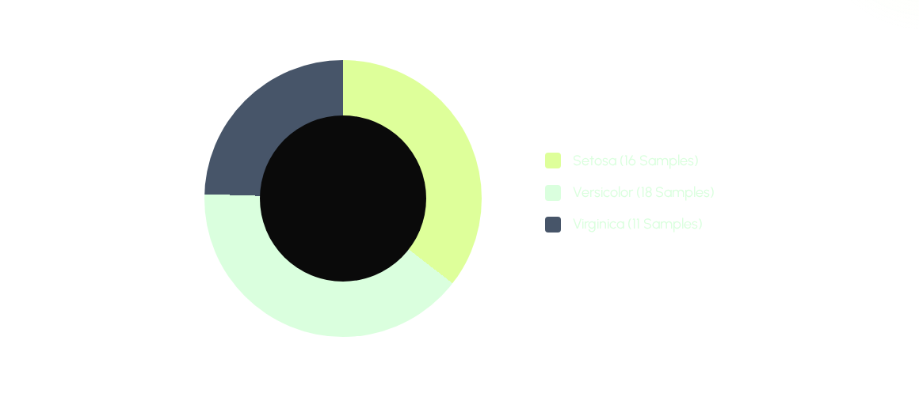
Data Distribution (Support)

Slide 10
"Not everything that can be counted counts, and not everything that counts can be counted."
— William Bruce Cameron

Slide 11
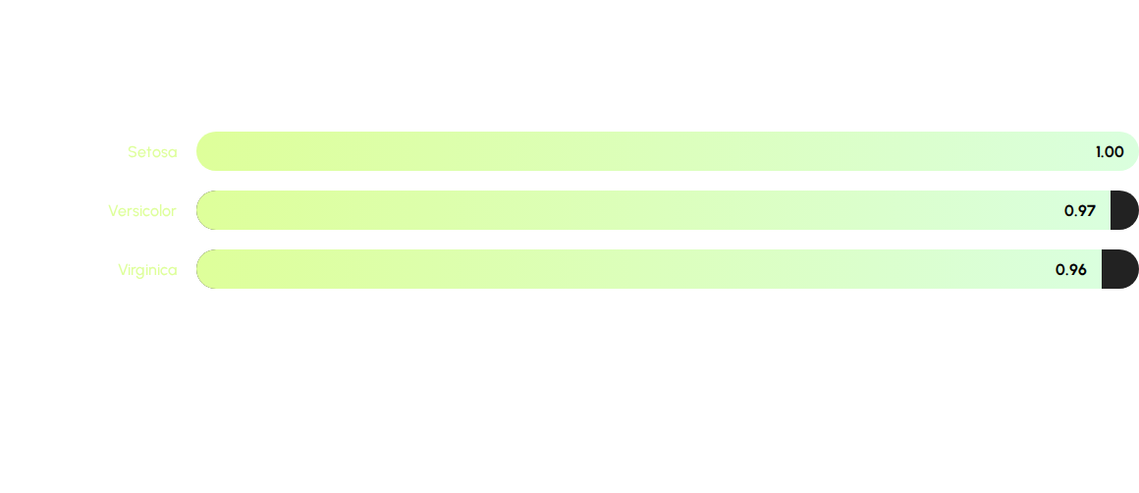
F1-Score Comparison per Species
The F1-score highlights that while all species perform well, Setosa remains the most perfectly separable class in this dataset.

Slide 12

Thank You!
Does this clarify why we look at more than just accuracy?

Slide 13



Image Sources
https://static.vecteezy.com/system/resources/previews/024/793/079/non_2x/target-or-bullseye-icon-a-focused-and-impactful-illustration-of-a-target-or-bullseye-representing-goals-objectives-and-precision-vector.jpg
Source: www.vecteezy.com
https://www.clipartmax.com/png/middle/87-871439_detective-eye-search-find-locate-icon-search-button-icon-png.png
Source: www.clipartmax.com
https://plus.unsplash.com/premium_photo-1764695511875-5f939ab9a031?fm=jpg&q=60&w=3000&ixlib=rb-4.1.0&ixid=M3wxMjA3fDB8MHxjb2xsZWN0aW9uLXBhZ2V8NHxMU1ZPRkhjMVFwVXx8ZW58MHx8fHx8
Source: unsplash.com

